Slide 1
Introduction to OpenFOAM
Open Source Computational Fluid Dynamics
Microcredential Module 1
Moodle-Compatible Learning Resource
OpenFOAM v13 / v2506

Slide 2

Learning Objectives
By the end of this module, you will be able to:
Explain what OpenFOAM is and its role in Computational Fluid Dynamics (CFD)
Describe the fundamental governing equations solved by OpenFOAM
Identify the key components of the OpenFOAM case directory structure
Outline the three-stage CFD workflow: pre-processing, solving, post-processing
Recognize the major solver categories and their applications
Understand the Finite Volume Method (FVM) as the core numerical technique
Appreciate the open-source ecosystem and community resources
Introduction to OpenFOAM — Microcredential Module 1
2 / 28

Slide 3

What is Computational Fluid Dynamics?
Definition
CFD Predicts
CFD is the use of applied mathematics, physics, and computational software to visualize how a gas or liquid flows — and how it affects objects as it flows past them.
Fluid flow patterns and velocity fields
Pressure distributions on surfaces
Temperature and heat transfer rates
Instead of building physical prototypes and running expensive wind tunnel tests, engineers can simulate fluid behavior computationally — saving time and cost.
Chemical reactions and combustion
Turbulent mixing and dispersion
Multiphase interactions (gas-liquid)
Introduction to OpenFOAM — Microcredential Module 1
3 / 28

Slide 4
What is OpenFOAM?
Open Source Field Operation And Manipulation
A free, open-source C++ toolbox for CFD with 1.5+ million lines of code, used by thousands of engineers and researchers worldwide.
Free & Open Source
C++ Codebase
Active Community
Bi-Annual Releases
Licensed under GNU GPL v3. No license fees, ever.
1.5M+ lines of high-performance C++ code with OOP design.
Thousands of users globally across industry and academia.
Regular updates: v2506 (ESI) and v13 (Foundation).
Introduction to OpenFOAM — Microcredential Module 1
4 / 28

Slide 5
History of OpenFOAM
1993
FOAM created at Imperial College London by Henry Weller
2004
Released as OpenFOAM under GNU GPL by OpenCFD Ltd
2011
OpenFOAM Foundation established; SGI acquires OpenCFD
2014
ESI Group acquires OpenCFD; dual release streams begin
2020
Major growth in industrial adoption and GPU computing
2025-26
OpenFOAM v13 (Foundation) and v2506 (ESI) released
Introduction to OpenFOAM — Microcredential Module 1
5 / 28

Slide 6
OpenFOAM Variants
Two main distributions maintained by different organizations
openfoam.com (ESI/OpenCFD)
openfoam.org (Foundation)
Maintained by OpenCFD Ltd (ESI Group)
Maintained by The OpenFOAM Foundation
Versioning: vYYMM (e.g., v2506)
Integer versioning (e.g., v13)
Bi-annual releases (June & December)
Led by CFD Direct (Henry Weller)
Strong industrial feature focus
Emphasis on code quality & design
Extensive documentation & tutorials
Modular solver framework
Introduction to OpenFOAM — Microcredential Module 1
6 / 28

Slide 7
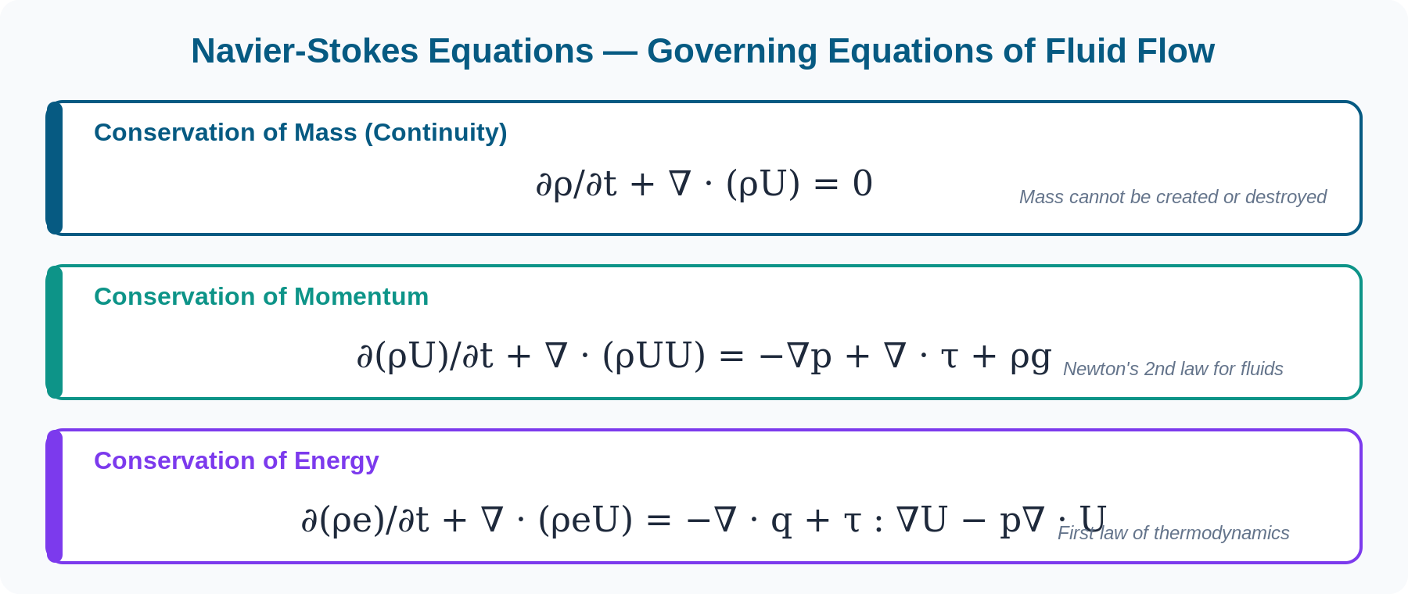
Governing Equations of Fluid Flow
Introduction to OpenFOAM — Microcredential Module 1
7 / 28

Slide 8
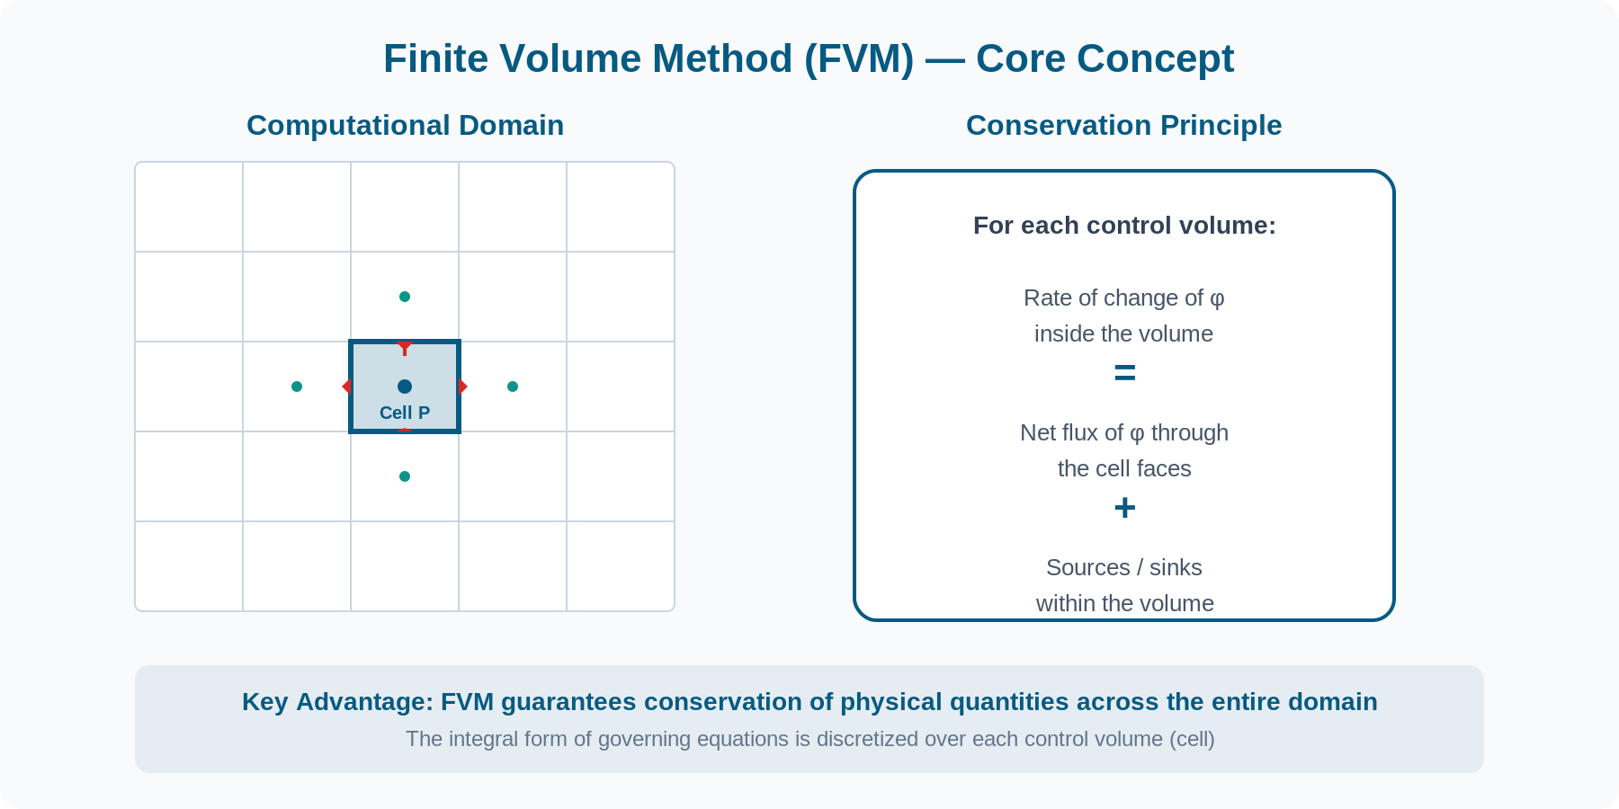
Finite Volume Method (FVM)
Introduction to OpenFOAM — Microcredential Module 1
8 / 28

Slide 9



Why Finite Volume Method?
Conservative
Flux entering one cell exactly equals flux leaving its neighbor — no artificial mass/energy creation.
Handles Complex Geometry
Works with unstructured meshes: tetrahedra, hexahedra, polyhedra — real engineering shapes.
Physically Intuitive
Each cell is a tiny control volume where conservation laws are enforced — direct physical interpretation.
Robust for CFD
Natural treatment of source terms, boundary conditions, and discontinuities in the flow field.
Introduction to OpenFOAM — Microcredential Module 1
9 / 28

Slide 10
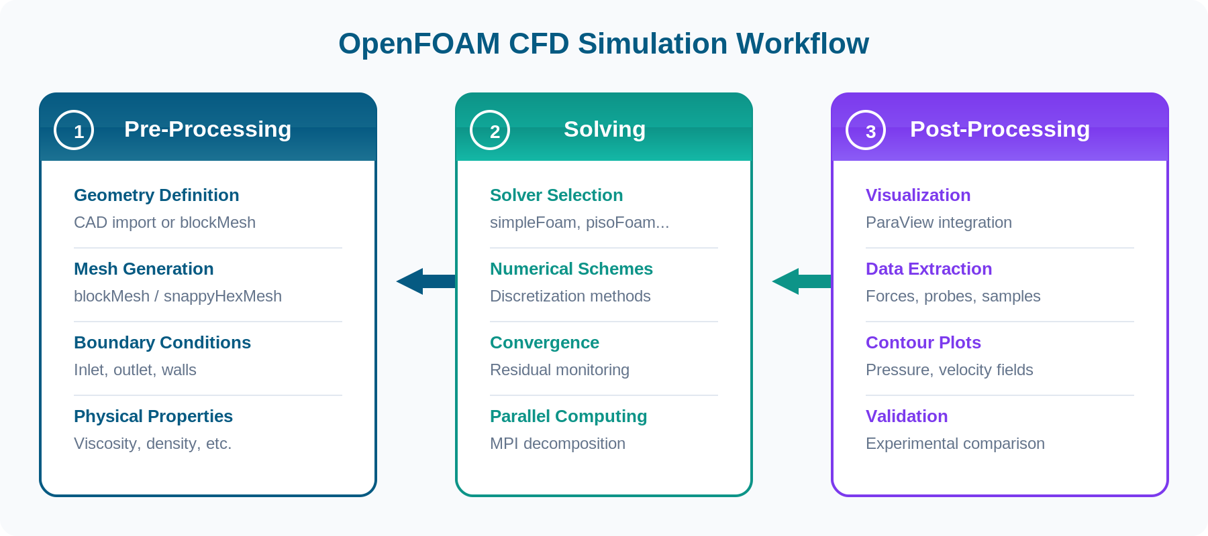
The CFD Simulation Workflow
Introduction to OpenFOAM — Microcredential Module 1
10 / 28

Slide 11
Stage 1: Pre-Processing
Geometry Definition
Define the computational domain using CAD tools or OpenFOAM's built-in blockMeshDict. Import external geometries in STL or OBJ format for complex shapes.
Mesh Generation
Create the computational grid using blockMesh (structured), snappyHexMesh (automatic hex-dominant), or external tools like cfMesh and Gmsh.
Boundary Conditions
Specify inlet velocities, outlet pressures, wall types (no-slip, slip), symmetry planes, and periodic boundaries in the 0/ directory.
Physical Properties
Set fluid properties: viscosity, density, turbulence model parameters, and transport properties in the constant/ directory.
Introduction to OpenFOAM — Microcredential Module 1
11 / 28

Slide 12
Meshing in OpenFOAM
blockMesh
snappyHexMesh
Structured hex mesh generator
Best for simple geometries (pipes, channels, boxes). Defined in system/blockMeshDict with vertices, blocks, and grading.
Advantages:
High quality hex cells
Full control over grading
Fast generation
Automatic hex-dominant mesher
Handles complex CAD surfaces (STL). Automatically refines, snaps to geometry, and adds boundary layers.
Advantages:
Handles complex geometries
Automatic surface refinement
Built-in layer addition
Introduction to OpenFOAM — Microcredential Module 1
12 / 28

Slide 13
Stage 2: Solving
The solver reads the case setup, assembles the discretized equations, and iterates toward a converged solution.
Select the Solver
1
Choose from 80+ solvers based on your physics: simpleFoam (steady incompressible), pisoFoam (transient), interFoam (multiphase), etc.
Configure Numerics
2
Set discretization schemes (fvSchemes) and linear solver settings (fvSolution). Balance accuracy vs. stability.
Monitor Convergence
3
Track residuals — the measure of how well the equations are satisfied. Residuals should drop 3-4 orders of magnitude.
Parallel Execution
4
Decompose domain with decomposePar, run across multiple cores with mpirun, and reconstruct with reconstructPar.
Introduction to OpenFOAM — Microcredential Module 1
13 / 28

Slide 14
Stage 3: Post-Processing
ParaView
Function Objects
Primary visualization tool. Create contour plots, streamlines, vector fields, iso-surfaces, and animations. Launched via paraFoam command.
Built-in runtime analysis: forces, pressure coefficients, field averages, probes, and sampling — all configured in controlDict.
Data Sampling
Validation
Extract data along lines, surfaces, or at probe points for quantitative comparison with experimental results.
Compare simulation results against analytical solutions, experimental data, or other CFD codes to verify accuracy.
Introduction to OpenFOAM — Microcredential Module 1
14 / 28

Slide 15
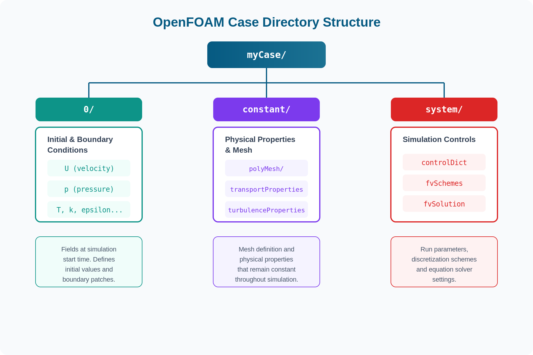
OpenFOAM Case Structure
Introduction to OpenFOAM — Microcredential Module 1
15 / 28

Slide 16
The 0/ Directory — Initial & Boundary Conditions
0/U (Velocity Field)
Key Elements
dimensions [0 1 -1 0 0 0 0];
internalField uniform (0 0 0);
boundaryField
{
inlet
{
type fixedValue;
value uniform (1 0 0);
}
outlet
{
type zeroGradient;
}
walls
{
type noSlip;
}
}
dimensions: SI unit dimensions of the field
internalField: Initial value throughout the domain
boundaryField: Conditions at each boundary patch
fixedValue: Dirichlet condition (set value)
zeroGradient: Neumann condition (zero derivative)
noSlip: Zero velocity at wall
Introduction to OpenFOAM — Microcredential Module 1
16 / 28

Slide 17
The constant/ Directory
polyMesh/
Physical Properties
points
List of all vertex coordinates
transportProperties
Kinematic viscosity, density
faces
Connectivity of vertices forming faces
turbulenceProperties
Turbulence model selection (laminar, RAS, LES)
owner
Cell owning each face
thermophysicalProperties
neighbour
Neighboring cell for internal faces
Thermodynamic and transport models
g
boundary
Boundary patch definitions
Gravitational acceleration vector
Introduction to OpenFOAM — Microcredential Module 1
17 / 28

Slide 18
The system/ Directory
controlDict
Master control file. Sets start/end time, time step (deltaT), write interval, solver application name, and runtime function objects.
fvSchemes
Discretization schemes for each term: time derivatives (ddtSchemes), gradients (gradSchemes), divergence (divSchemes), and Laplacian (laplacianSchemes).
fvSolution
Linear equation solver settings, tolerances, relaxation factors, and algorithm controls (SIMPLE, PISO, PIMPLE parameters).
Introduction to OpenFOAM — Microcredential Module 1
18 / 28

Slide 19
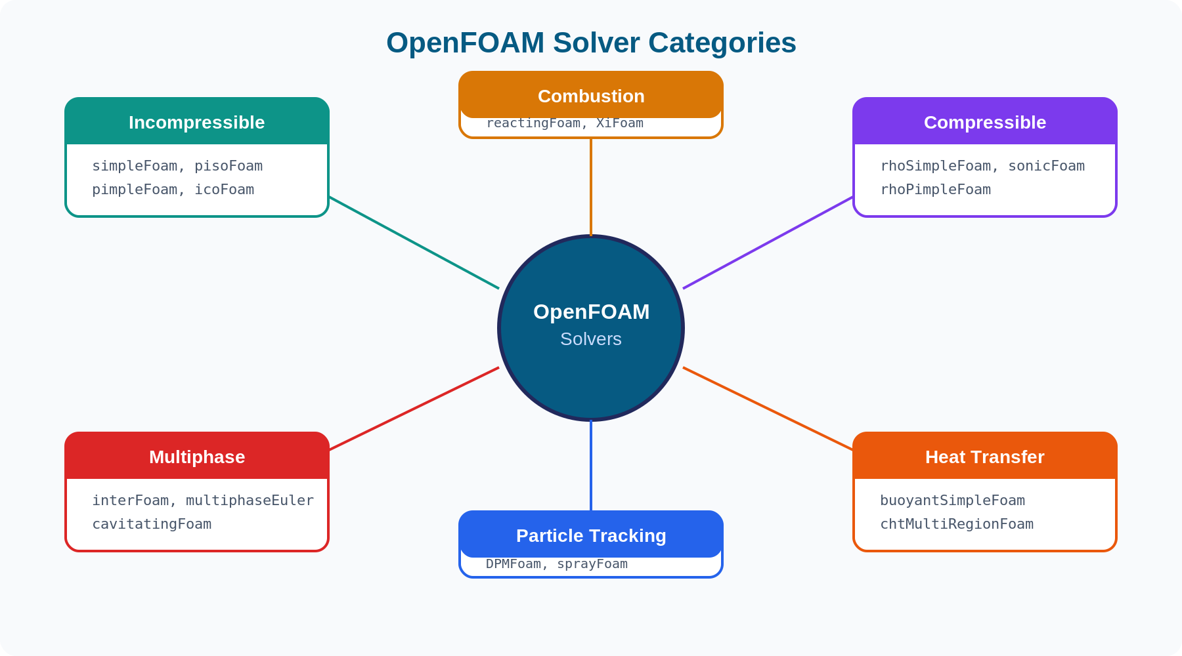
OpenFOAM Solver Categories
Introduction to OpenFOAM — Microcredential Module 1
19 / 28

Slide 20
Commonly Used Solvers
Solver | Type | Physics | Use Case
simpleFoam | Steady | Incompressible, turbulent | External aerodynamics
pisoFoam | Transient | Incompressible, turbulent | Vortex shedding
pimpleFoam | Transient | Incompressible, turbulent | General unsteady flows
icoFoam | Transient | Incompressible, laminar | Tutorial / simple cases
interFoam | Transient | Multiphase (VOF) | Free surface flows
rhoSimpleFoam | Steady | Compressible | High-speed flows
buoyantSimpleFoam | Steady | Heat transfer | Natural convection
Introduction to OpenFOAM — Microcredential Module 1
20 / 28

Slide 21
Turbulence Modeling in OpenFOAM
RANS (Reynolds-Averaged)
Most Used
Time-averaged equations with turbulence models. Most common for engineering. Models: k-epsilon, k-omega SST, Spalart-Allmaras.
LES (Large Eddy Simulation)
High Fidelity
Resolves large eddies, models small ones. More accurate but computationally expensive. Models: Smagorinsky, WALE, dynamic.
DNS (Direct Numerical Simulation)
Research
Resolves all turbulent scales. Extremely expensive — only feasible for low Reynolds numbers and research.
Introduction to OpenFOAM — Microcredential Module 1
21 / 28

Slide 22
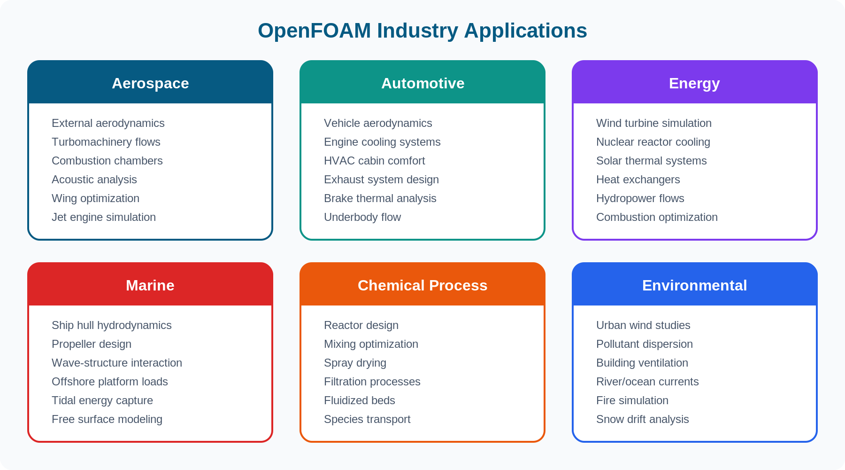
Industry Applications
Introduction to OpenFOAM — Microcredential Module 1
22 / 28

Slide 23
OpenFOAM vs. Commercial CFD
Feature | OpenFOAM | Commercial (e.g., ANSYS Fluent)
Cost | Free (GPL v3) | $20,000-$50,000+/year
Source Code | Fully accessible & modifiable | Closed / black box
GUI | Command-line (third-party GUIs) | Polished integrated GUI
Customization | Unlimited (C++ / Python) | Limited UDF/scripting
Scalability | No license limits on cores | License-limited parallelism
Support | Community + paid options | Vendor support included
Learning Curve | Steeper (Linux/CLI focused) | Gentler (GUI-guided)
Introduction to OpenFOAM — Microcredential Module 1
23 / 28

Slide 24
Installation & Platforms
Native Linux
Windows (WSL)
Best performance. Ubuntu is recommended. Install via package manager (apt) or compile from source.
Run OpenFOAM through Windows Subsystem for Linux. Full functionality with native-like performance.
Docker Containers
macOS
Pre-configured containers for quick setup. Ideal for consistent environments across teams.
Compile from source or use Docker. Not officially supported but community solutions exist.
Introduction to OpenFOAM — Microcredential Module 1
24 / 28

Slide 25
Running Your First Simulation
$ cd $FOAM_TUTORIALS
Navigate to tutorials directory
$ cp -r incompressible/simpleFoam/pitzDaily .
Copy the cavity tutorial case
$ cd pitzDaily
Enter the case directory
$ blockMesh
Generate the mesh
$ simpleFoam
Run the solver
$ paraFoam
Visualize results in ParaView
Introduction to OpenFOAM — Microcredential Module 1
25 / 28

Slide 26
Community & Resources
Official Documentation
CFD Direct Guide
openfoam.com/documentation — comprehensive user guide, programmer guide, and tutorial guide.
doc.cfd.direct — extensive user guide for Foundation releases with practical examples.
OpenFOAM Wiki
Forum & Mailing Lists
Community-driven wiki with tips, tutorials, and troubleshooting guides.
cfd-online.com/Forums/openfoam — active community forum for Q&A and discussion.
YouTube Tutorials
Published Textbooks
Multiple channels offering step-by-step video tutorials for all skill levels.
Multiple textbooks available for structured learning, from beginner to advanced.
Introduction to OpenFOAM — Microcredential Module 1
26 / 28

Slide 27

Key Takeaways
OpenFOAM is a powerful, free, open-source CFD toolbox used worldwide in industry and academia
It solves the Navier-Stokes equations using the Finite Volume Method (FVM)
Every simulation follows three stages: pre-processing, solving, post-processing
The case structure has three directories: 0/ (conditions), constant/ (properties), system/ (controls)
80+ built-in solvers cover incompressible, compressible, multiphase, heat transfer, and more
The open-source nature enables unlimited customization and zero-cost parallel scaling
Introduction to OpenFOAM — Microcredential Module 1
27 / 28

Slide 28

What's Next?
Complete the assessment activity to test your understanding
Take the Moodle Quiz to assess your understanding
Try the interactive H5P activities for hands-on learning
Set up OpenFOAM on your system
Run the lid-driven cavity tutorial case
Module 1 of OpenFOAM Microcredential

